Slide 1
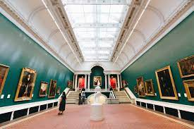






Trippr
A fun tool to assist your travel decision
Designed By:
Juanita, Tanav, Bryan, Keith, Eve

Slide 2
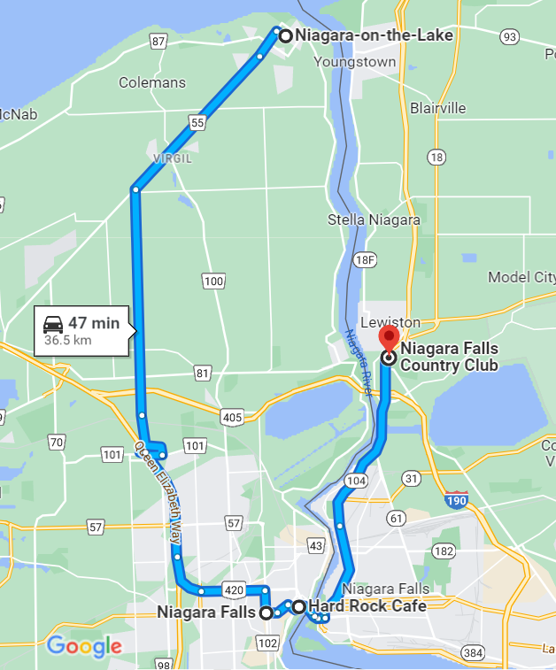



What is Trippr
What you will get:
A fun tool to find your best interests around you
- First:
Tell us above yourself
- Second:
Trippr will recommend a list of what you like.
- Last, but not the least:
Select what you like to get more details.
Stop
Make your way to great pictures at Niagara Falls
Stop
Grab an amazing Burger and Fries at Hard Rock Café
Stop
Wrap your day with a Golf Game at the Niagara Falls Country Club
1
2
3
3
1
2

Slide 3






Resources and Technologies
Resources:
Google Map
Trip Advisor
Others (if possible)
Collecting User inputs
Technologies:

Slide 4





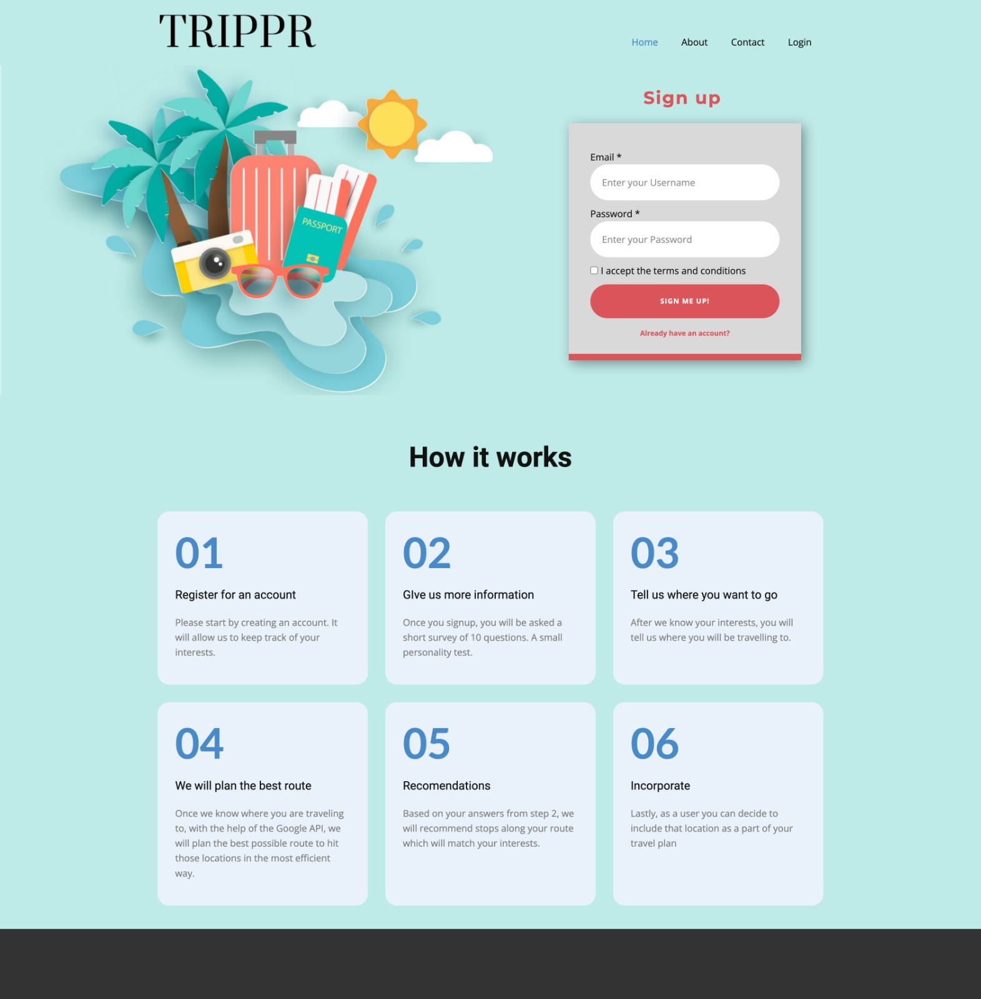
Process Flow and Diagram
ML Model
Training Initial Data
+
Retraining by collecting More
HTML
Input - User Registration
Input - User survey
Output - Gmap
Output - Recommendation
Research
HTML
Project Planning
Brain Storming
Research
Process Design
Data Download
ETL & Data Store
Data Profiling
Database Design
Load to DB
Optional
Data Store
Collect User Info
Store in database

Slide 5
ML Model Diagram
Database
Unsupervised ML Model
Input
Data Preparation
Scaling
Output
Rating Data
PCA Setting
Group data into clusters
Category Table
User Table
Find the best value for K
Plot data and Validation

Slide 6
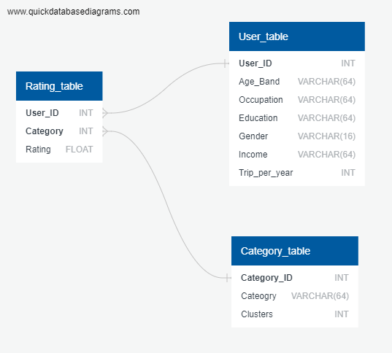
Data Base ERD (Preliminary)

Slide 7
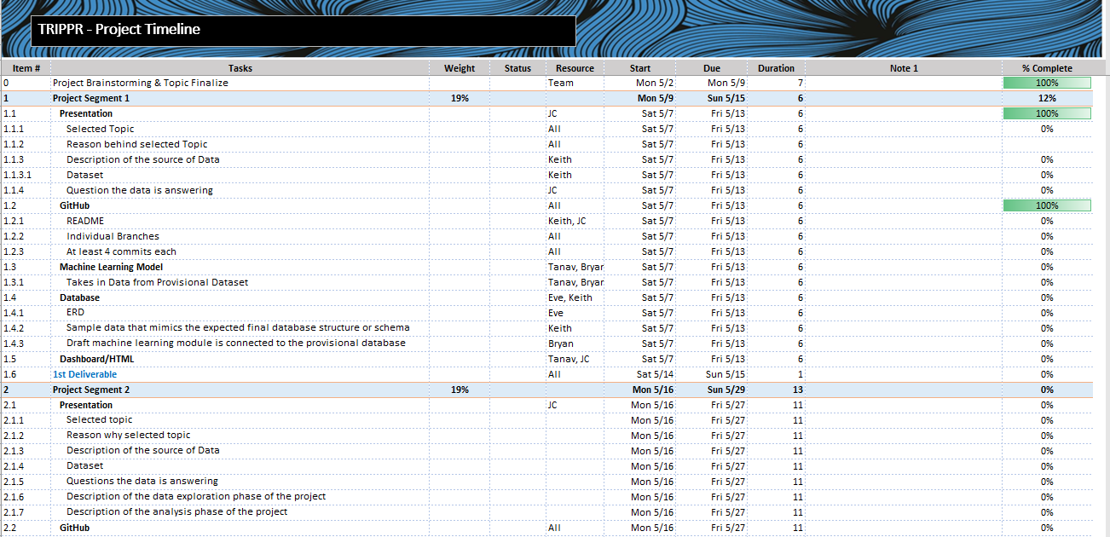
Project Timeline
https://github.com/juanitacosmica/FinalProject_RoadTrippr/blob/main/TRIPPR%20Milestones%20051322.xlsx

